Slide 1
Developing a Website “MEMORIES”
Event Management Website
Niharika Gurav
SY COMP A
UCE2021422

Slide 2
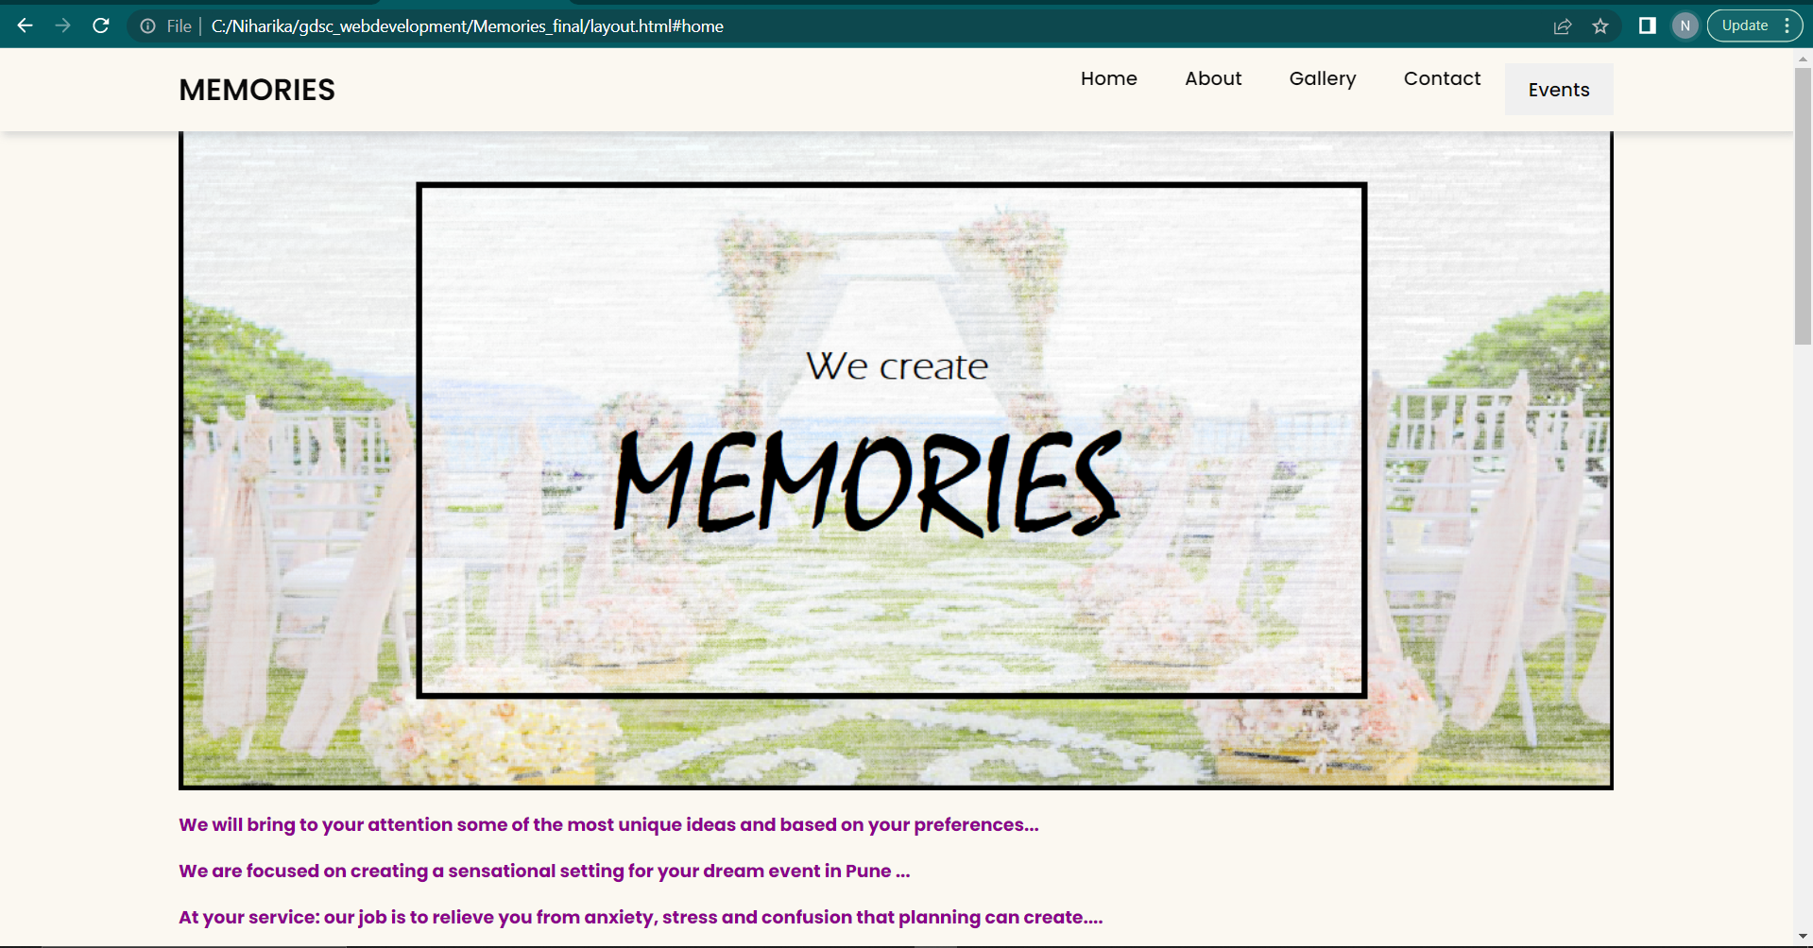
Main Page- HOME

Slide 3
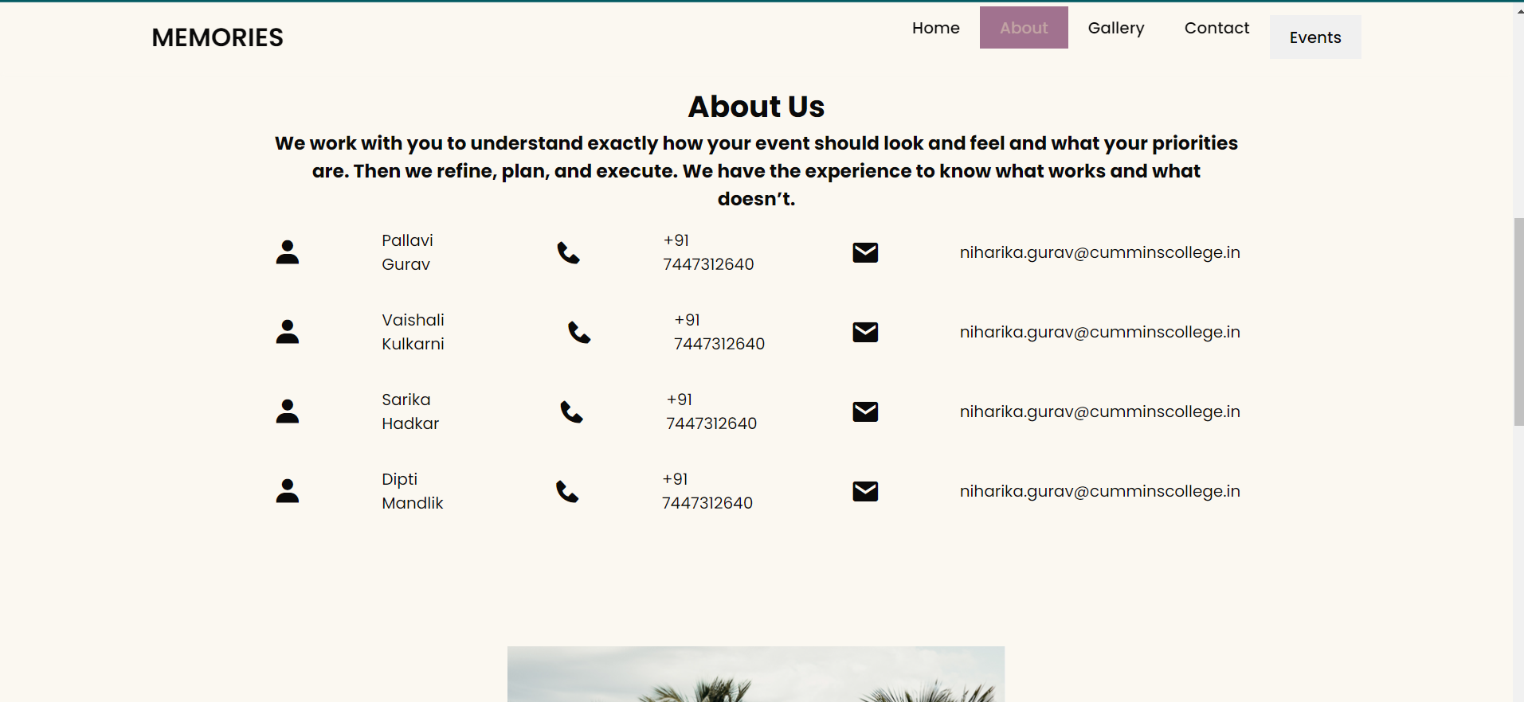
ABOUT

Slide 4
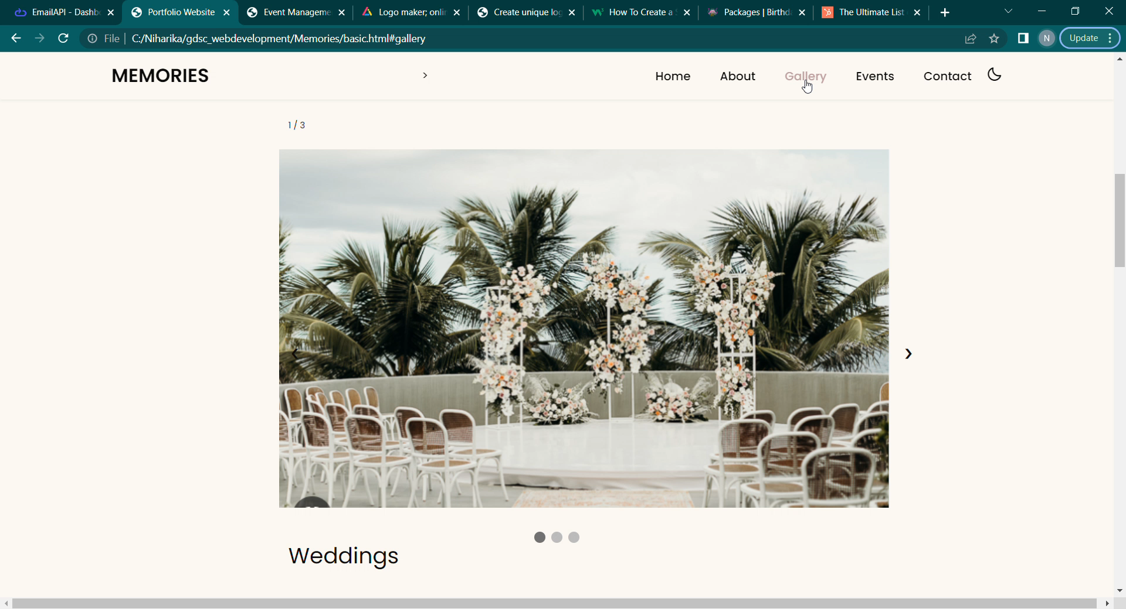
GALLERY
GALLERY(Video)

Slide 5
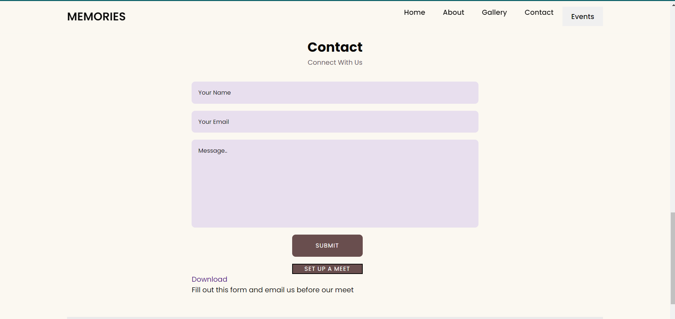
CONTACT

Slide 6
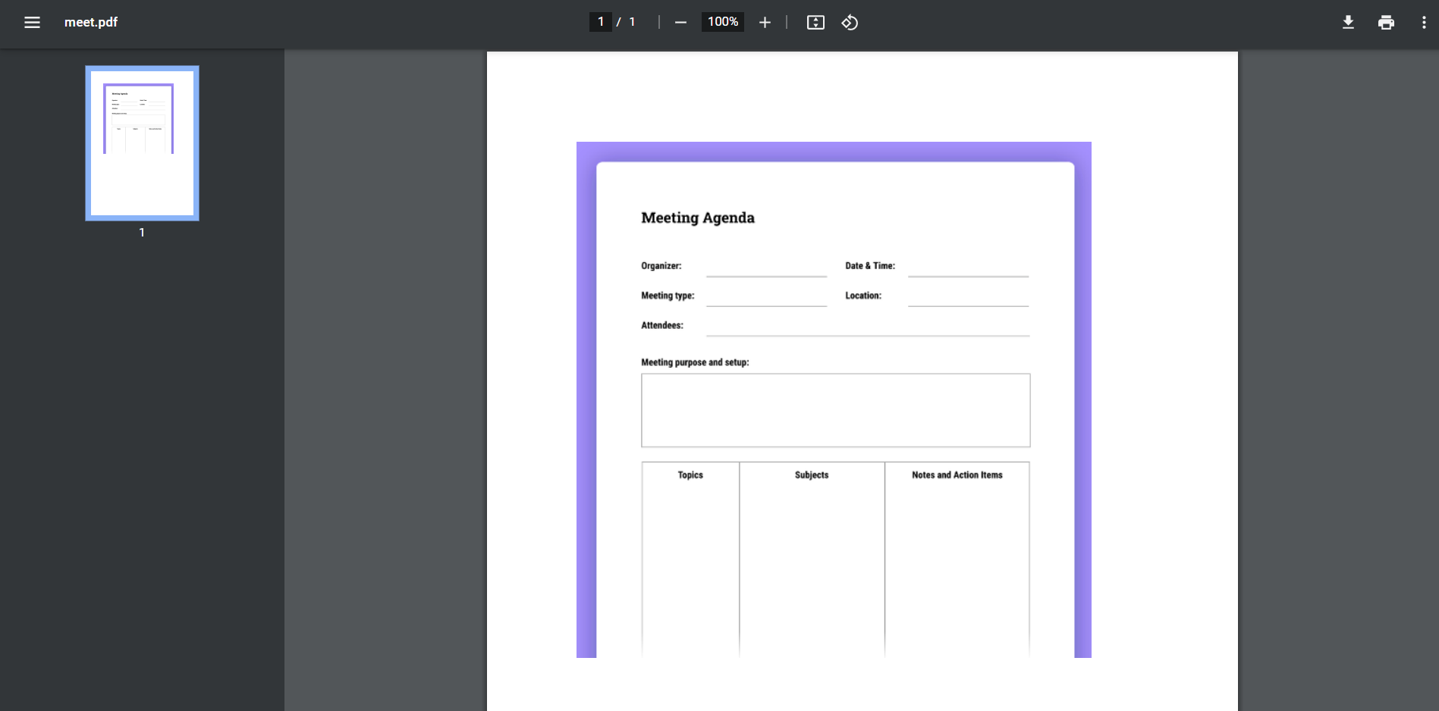
(Download pdf)

Slide 7
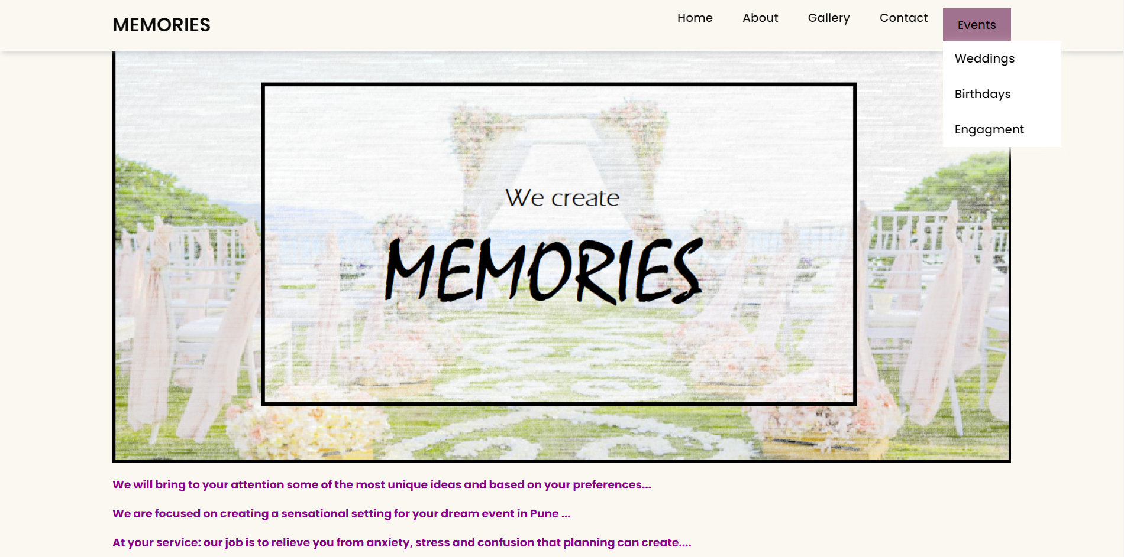
EVENTS

Slide 8
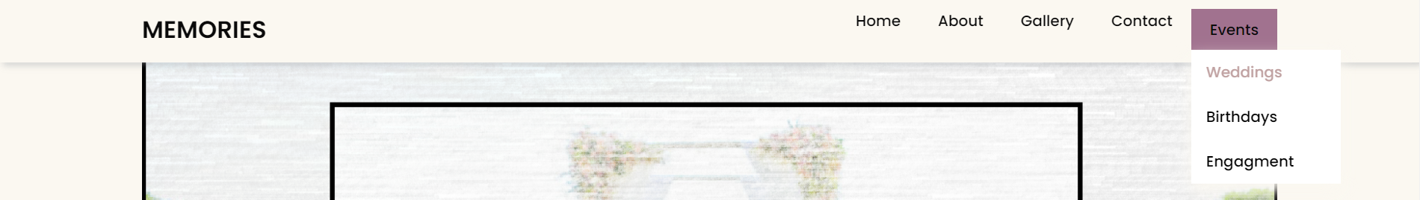

Wedding section

Slide 9
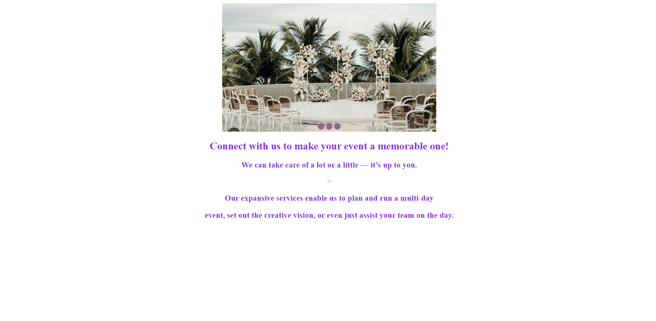
(Slide show)

Slide 10
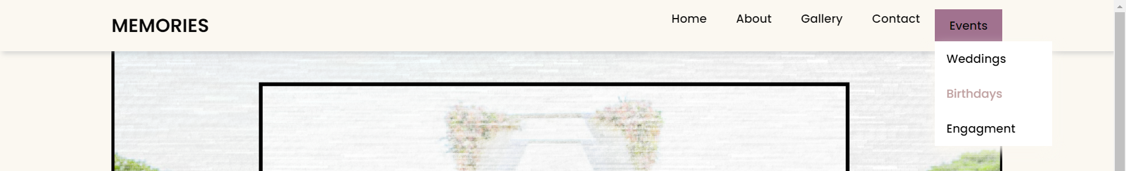

Birthday section

Slide 11
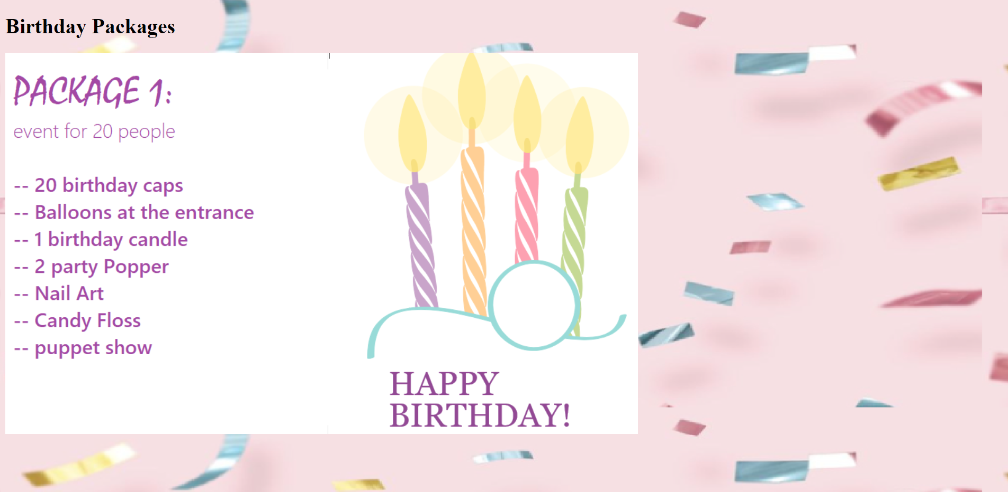
Birthdays

Slide 12
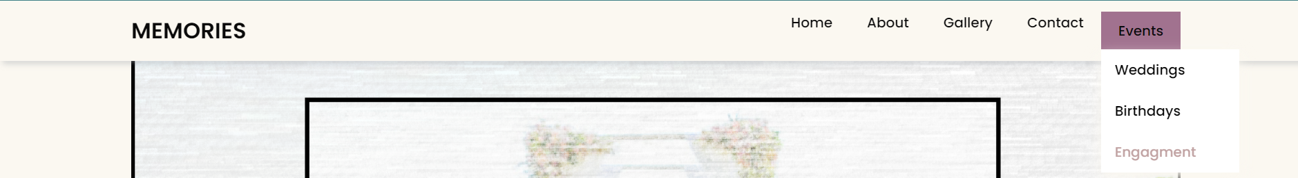

ENGAGEMENT section

Slide 13
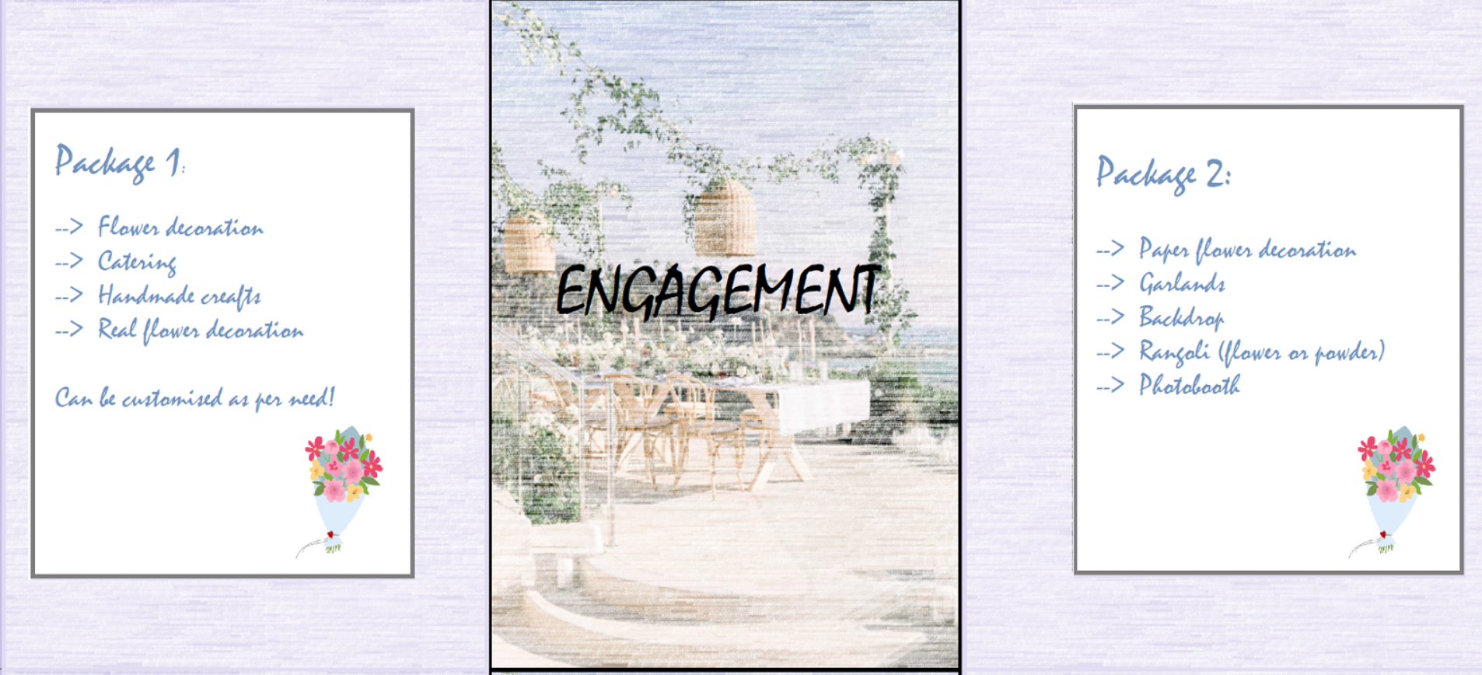
ENGAGEMENT

Slide 14

FOOTER

Slide 15
THANK YOU!

